Slide 1
RPA ML use case ID 3- Business case Document
Srikanth Jonnavithula

Slide 2
Business case
Extract Details from Received Bill document and create an excel table and send it to the customer
  Received bill is from logistics Service Provider currently in scope is limited to 3 LSPs
  The format of the received documents may vary based on below criteria
    LSP
    Mode of transport

Slide 3




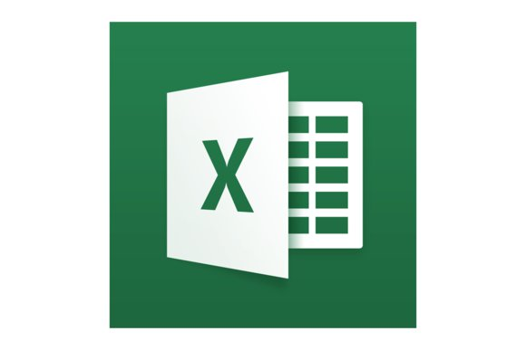
OCR, ML and RPA solution for Pre-Alert
Free Trade Zone
Warehouse Team
2. Send the email with the attached Excel file on weekly basis
Email with Invoice
1. Fill in the Excel file with the predefined column structure
Supplier
3 Logistics Service Providers:
K&N
DSV
DGF
PHX Pre-Alert Group Mailbox
OCR
ML
RPA
Email with Pre-Alert Package:
PDF Invoice
PDF Bill of Landing
PDF Packing List (optional)
Note : Intelligent Filtering of mail Box is out of scope for now

Slide 4
Number of Documents required for analysis and development to build this use case?
Technology that will be used? And Why ?
Number of days required to build this use case ?

